Slide 1

VeriPass
November 17, 2024

Slide 2
Team Introduction
Trainee | Parthik Kumar Das Software Engineer Trainee Hyderabad
Frontend Mentor | Varsha G M Software Engineer Telecom, Chennai
Backend Mentor | Saravanan A Technical Lead Telecom, Chennai

Slide 3
Agenda
Problem Statement
Objectives
Sprint Planning
Technologies Used
Telecom Domain Specifics
Data Flow Diagrams
Modules : Server Side and Client Side
Testing
Challenges Faced and Learning Outcomes
Demo
Future enhancements

Slide 4
Challenges in Existing System :
Issue / Deficiencies:
Lack of robust scalable micro service architecture | Reliability Concerns
Complex Deployment of monolithic architecture | Maintenance Difficulties
Impact of the Issue:
Increased risk of unauthorized access and data breaches.
Potential financial and reputational damage to companies.
Problem Root Cause Analysis:
Lack of a centralized system to manage and validate password policies.
Insufficient integration of security measures within existing systems.

Slide 5
Problem Statement
In the dynamic and highly competitive telecom industry, safeguarding user accounts and sensitive data is critical. Telecom companies are confronted with unique challenges such as managing vast amounts of user data, adhering to stringent regulatory compliance, and countering advanced cyber threats. Traditional password-based authentication methods fall short in providing adequate security. Therefore, there is an urgent need for an advanced, scalable, and secure system that can enforce stringent password policies
Benefits of VeriPass :
Scalability: Independent Scaling, Optimized Resource Usage, Improved Performance
Maintenance: Loose Coupling, Easier Updates, Component Replacement
Reliability: Enhanced Availability, Improved System Reliability, More Security.
Centralized Control: Dynamic Service Discovery, Optimized Load Balancing, Enhanced Security, Simplified CORS Handling, Rate Limiting, Improved Developer Productivity

Slide 6
Objective
- Enhance Security: Implement advanced password strength detection.
- Scalability: Develop a scalable microservice architecture for high traffic volumes.
- Regulatory Compliance: Ensure compliance with TRAI and FCC standards.
- Seamless Integration: Integrate with existing telecom OSS/BSS systems.
- Optimized Load Balancing: Efficiently distribute traffic using load balancing.
- Centralized Control: Implement a gateway for rate limiting and security policies.
- Rate Limiting: Control traffic to prevent abuse and DoS attacks.
- Enhanced Reliability: Ensure fault isolation and continuous service availability.
- User Interactivity: Develop a Three.js interactive website to engage users.

Slide 7
Sprint Planning
Sprint | Work Done
Week 1 | -> Analyzing problem Statement and Objectives. -> Identifying Tech Stack.
Week 2 | -> Database Schema and System Architecture. -> Split the problem into smaller problem.
Week 3 | -> Design Backend and all endpoints. -> Setup communication between services. -> MySql setup and connection.
Week 4 | -> Design Frontend. ->Create various interactive components. ->Connecting Backend with Frontend.
Week 5 | -> Additional user specific features. ->Handle edge cases. -> Testing of components and endpoints.

Slide 8

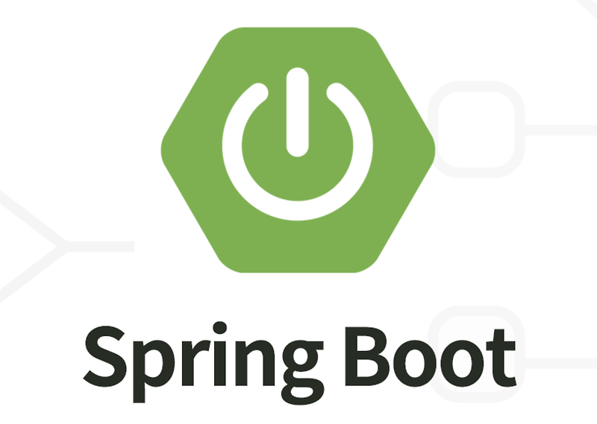



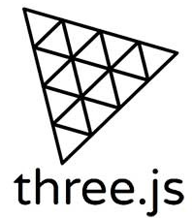

Technologies Used:
Backend :
Frontend :
8

Slide 9
Telecom Domain Specifics:
1. Telecom Regulatory Bodies
Telecom companies often need to comply with specific security standards set by regulatory bodies like the Telecom Regulatory Authority of India (TRAI) or the Federal Communications Commission (FCC) in the US. Example Policies: These might include requirements for password complexity (minimum length, use of special characters etc), regular password changes, and restrictions on password reuse.
Reasons for alignment of project with Telecom Regulatory Bodies:
Parameters like minimum length, maximum length, upper case, lower case, digits, HasSpecialCharacters are implemented.

Slide 10
Telecom Domain Specifics:
2. Integration with Telecom BSS
Telecom OSS (Operation Support Systems) - Information processing sytems used by operators to manage their communications network. It helps the organisation to focus on network management, fault management and network configuration.
Telecom BSS (Business Support Systems) - Allows to connect with the customers and handling business-related functions such as CRM, creates Products and Services.
Reasons for alignment of project with BSS (Business Support Systems):
User Registration: Companies register and define their password policies.
API Management: Provide API key, URL for integrating the password checker.
Security Verification: Using JWT and MFA for security verification.
The project enhances security, it doesn’t directly deal with network operations or management tasks typically handled by OSS.

Slide 11
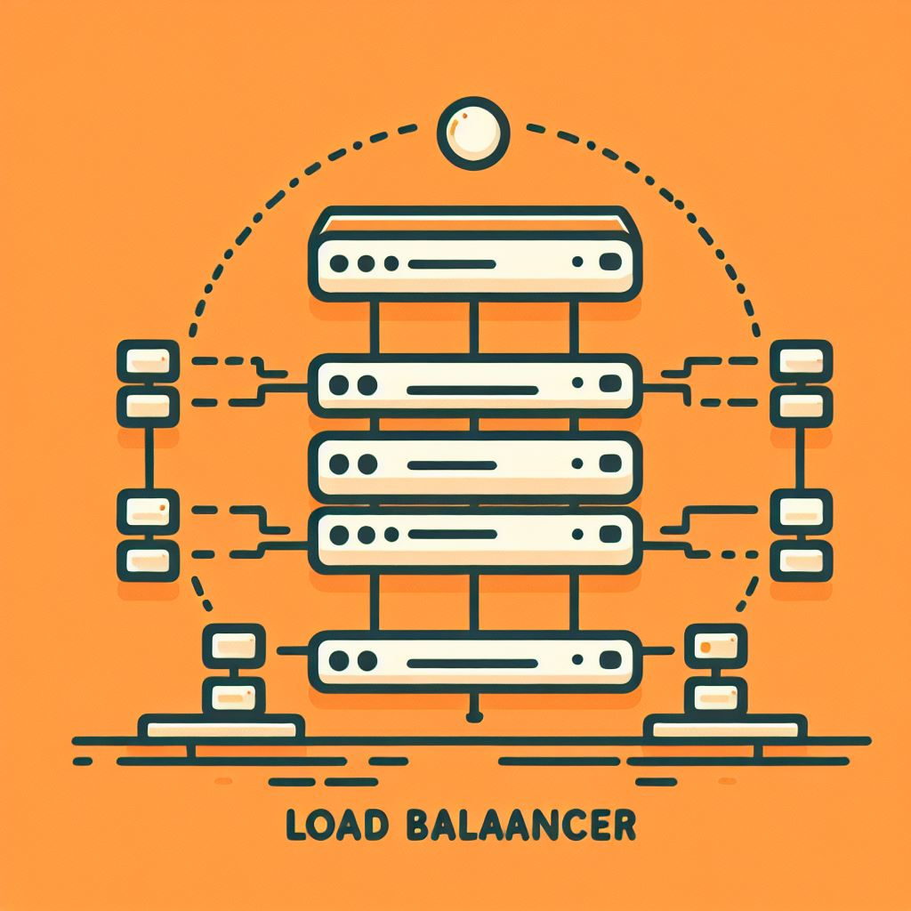
Telecom Domain Specifics:
3. Multi-Factor Authentication (MFA)
Layered Protection: MFA adds an extra layer of security by requiring users to verify their identity through an additional method, such as an email, reducing the risk of unauthorized access even if the JWT token is compromised.
Reasons for alignment of project with MFA:
Two Layers of Protection: Even if an attacker obtains the user's password, they still need access to the user's email to retrieve the OTP.
Time-Limited OTPs: OTPs are typically valid for a short period.
Reason for choosing otp over captcha:
AI and CAPTCHA: AI can pass CAPTCHA and often captcha is unreadable by humans.
Human Verification: Email OTP require human interaction.
No Additional Apps: Unlike some MFA methods that require authenticator apps this only require access to the email account.

Slide 12
Telecom Domain Specifics:
4. Load Balancing
In the telecom industry, load balancing helps distribute voice and data traffic across multiple servers or network paths to prevent congestion and ensure smooth communication. By distributing traffic across multiple servers, load balancing ensures that if one server fails, others can take over, minimizing downtime and maintaining service continuity.
Reasons for alignment of project with Load Balancing:
Eureka helps with load balancing by providing service discovery ensuring that traffic is evenly spread across all instances, preventing any single instance from being overwhelmed.
Rate limiting helps load balancing by controlling the number of requests a server handles, preventing overload.

Slide 13

Telecom Domain Specifics:
5. Rate Limiting
In the telecom industry, rate limiting is crucial for preventing network congestion by controlling data flow, ensuring stable and reliable service. It enhances security by mitigating DDoS attacks and preventing abuse of network resources. Additionally, it ensures fair usage among users, maintaining a high quality of service for all customers.
Reasons for alignment of project with Load Balancing:
Limits login attempts to prevent brute force attacks, enhancing security.
Controls request rate to ensure the service remains responsive and available to all users.
Aligns with industry standards by providing a balanced approach to security and performance.

Slide 14
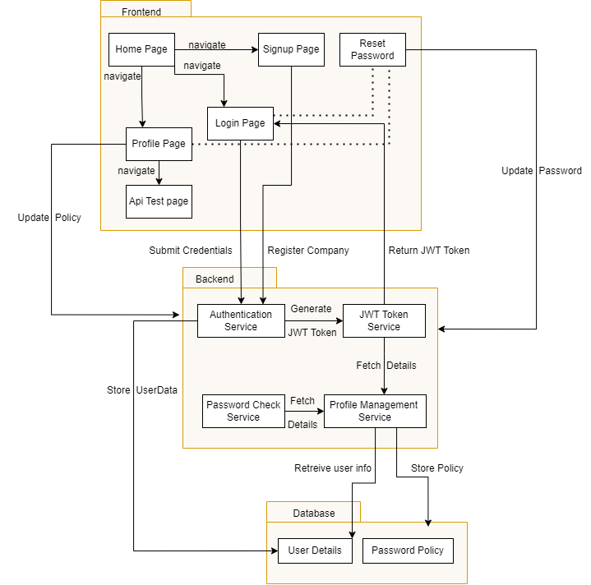
Data Flow Diagrams

Slide 15
Client Side Modules Server Side Modules
Home Page - Welcome page with navigation options.
Login and Signup Pages :
Signup: Register by details and password policy.
Login: Using credentials and receive a JWT token.
Forget Password: Using OTP change password.
Profile Section
Access: Companies use JWT token to access profile.
Display Details: Fetch and display company details using the JWT token.
Update Policy: Companies can update their password policy.
Update Password: Update password policy
Test Api: Test password against policy.
1. Authentication Module: Handles login, registration JWT token generation.
2. Policy Management Module: Allows companies to define and update password policies.
3. Password Validation Module: Validate user passwords against defined policies.
4. Database Module: Manages data storage using MySql.
5. Eureka Server & Feign Client: Exposes services to other systems and manages communication between services.
6. Gateway: Uses rate limiting, CORS Filter and provides a central location.

Slide 16
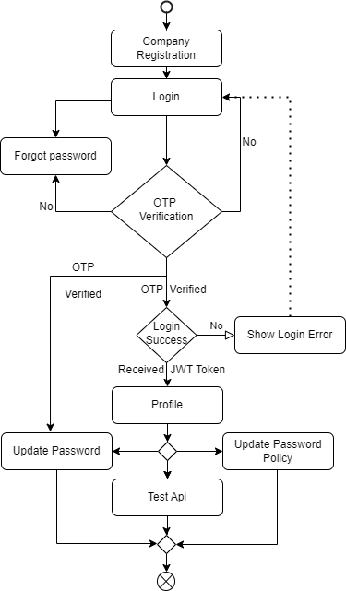
Data Flow
Company Registration
Input: Details and password policy.
Process: Validate and store details.
Output: Registration confirmation.
Company Login
Input: Email and password.
Process: Validate, generate JWT token.
Output: Access to company panel.
Accessing the Panel
Input: JWT token.
Process: Verify token, grant access.
Output: API key, policy management.
Updating Password Policy
Input: New policy details.
Process: Validate and update policy.
Output: Update confirmation.
Testing Api
Input: Testing Password.
Process: Check with the policy of company.
Output: Validation result (pass/fail). Password Validation
Input: User password.
Process: Fetch policy, validate password.
Output: Validation result (pass/fail).

Slide 17
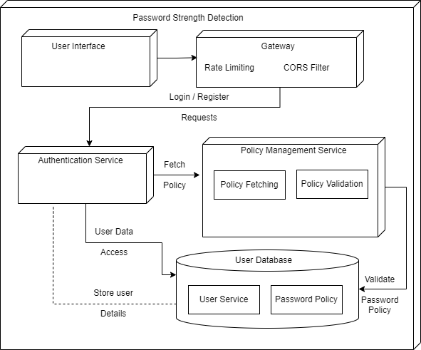
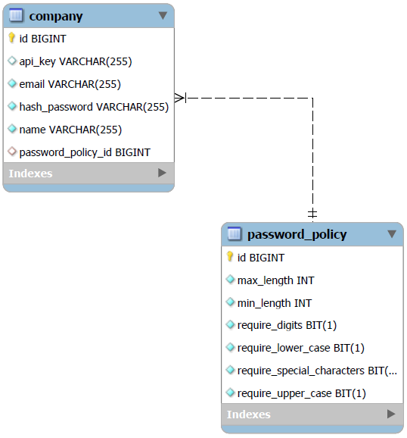
Data model Diagram ER Diagram

Slide 18
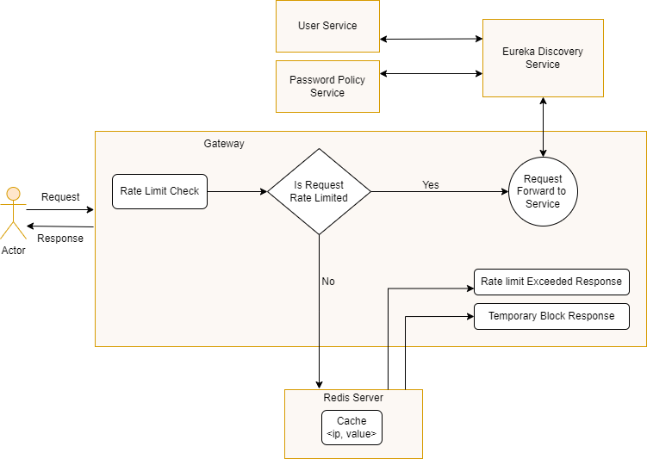
Gateway - Rate Limiting
Gateway: Single entry point for all requests, applying rate limiting and routing to appropriate microservices.
Rate Limiting: Controls the rate of incoming requests to prevent abuse and ensure fair usage.
Redis: An in-memory data store used for fast access and updates.
IP-Based Tracking: IP is tracked with a unique key-value pair in Redis.
Cache Storage: The cache is stored in Redis.
- Key-Value Pair: <IP, reqCount>
- Expiration Time: Each key has an expiration time of 1 second, resetting every second to create a new rate limiting window.

Slide 19
API Endpoints :
Endpoint | Method | Parameters | Action
http://localhost:8084/auth/register | POST | Details of company and policy as JSON. | Register the company.
http://localhost:8084/auth/login | GET | Email and Password as Params | Login
http://localhost:8084/otp/generate-otp?email=${email} | POST | Email as path variable. | Generates and sends otp in mail.
http://localhost:8084/otp/verify-otp?email=${email}&otp=${otp} | POST | Email and otp as path variable. | Verifies the otp.
http://localhost:8084/auth/user | GET | Authorization Bearer Token | Fetches the details.
http://localhost:8084/auth/user | PUT | New Password Policy as JSON and Authorization Bearer Token | Updates the policy.
http://localhost:8084/auth/logout | POST | Authorization Bearer Token | Logout
http://localhost:8084/auth/resetPassword | POST | New Password as JSON and Authorization Bearer Token | Reset Password
http://localhost:8084/userPasswordCheck/api | POST | API Key and Test Password as JSON | Test Password against Policy.

Slide 20
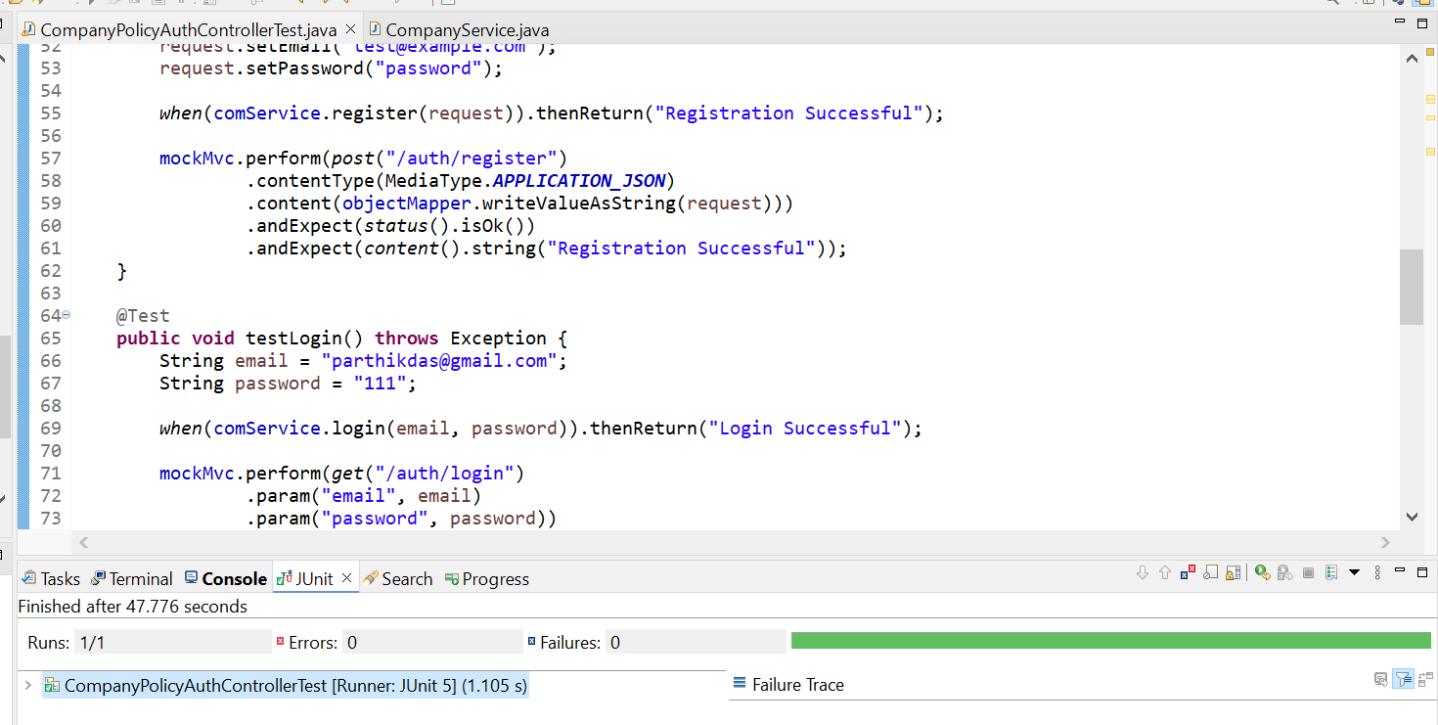
Testing :
Tools and Frameworks Used :
JUnit: For writing and running the test cases.
Mockito: For mocking the service layer and dependencies.
Spring Boot Test: For integration testing.
MockMvc: For testing the controller endpoints.
Frontend
Successfully tested the frontend components for functionality, integration, and error handling. All major functionalities are working as expected, providing a seamless user experience.

Slide 21
Api Testing
To test how the server reacts to too many requests, we use the following curl command:
It is a formal loop of accessing the end point and printing the status.
Normal Response: 200 OK
High Request Volume Response: 429 Too Many Requests
Rate Limiting Configuration :
redis-rate-limiter.replenishRate: 10
redis-rate-limiter.burstCapacity: 20
These settings control the rate and capacity of requests the server can handle.
for /L %i in (1,1,20) do curl -s -w "\nHTTP Status: %{http_code}\n" -X GET "http://localhost:8084/auth/login?email=parthikdas@gmail.com&password=123"

Slide 22
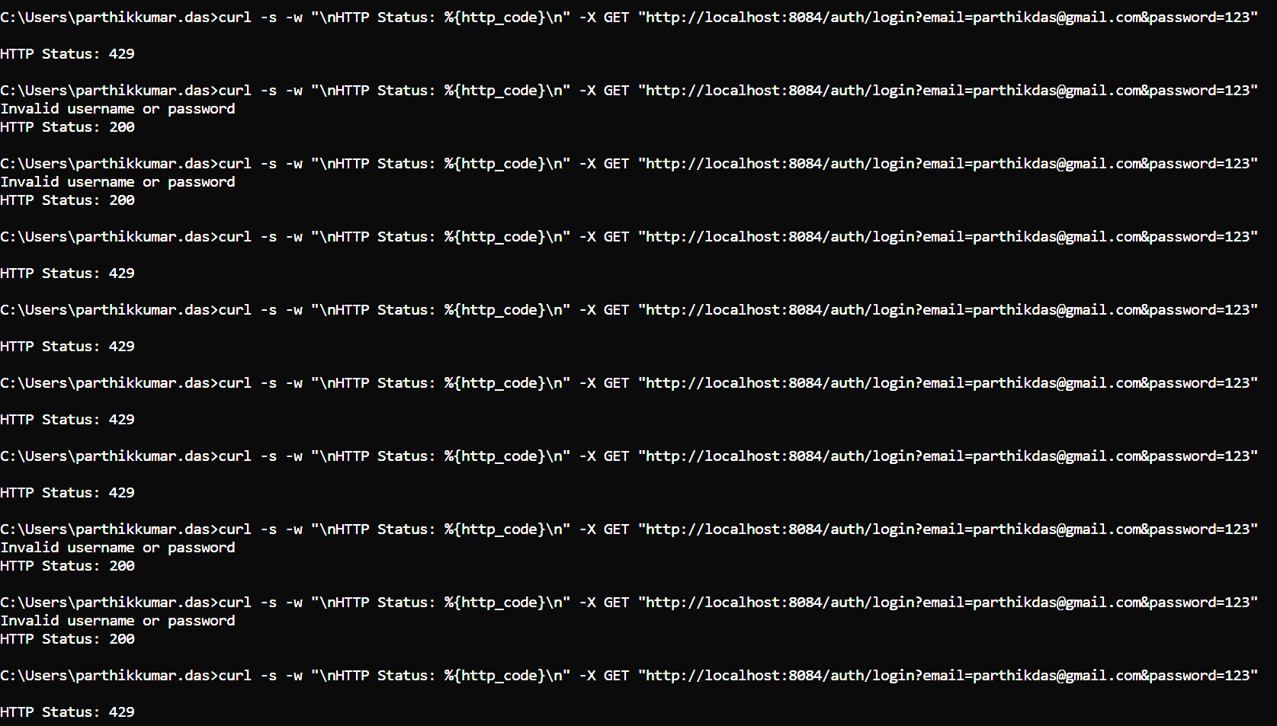

Slide 23
Challenges Faced and Learning Outcomes
One challenge was enabling communication between two microservices using a Feign client. The solution was to restart the server, but this took considerable time as various approaches were tried.
Another challenge was setting up the gateway to discover services via the Eureka server. Despite the services being registered, they were not accessible through the gateway. The solution, once again, was to restart the server.
Initially, I didn't plan for rate limiting, so each micro service had its own CORS filter. After implementing the gateway, I needed to add a CORS filter. there as well, causing conflicts. The solution was to remove the CORS filters from the services and keep it only in the gateway.
While using Three.js to create a 3D interactive background, I set up one scene for the background and another for the homepage. Redirecting to another page caused errors because the scene needed to be removed. The solution was to efficiently manage the DOM and callbacks.
To make certain states available across all components, I used the useContext hook.
The server was becoming overloaded due to too many requests, causing it to slow down. To address this, I implemented a gateway for rate limiting. Now, when there are too many requests, the server responds with a "too many requests" message.

Slide 24
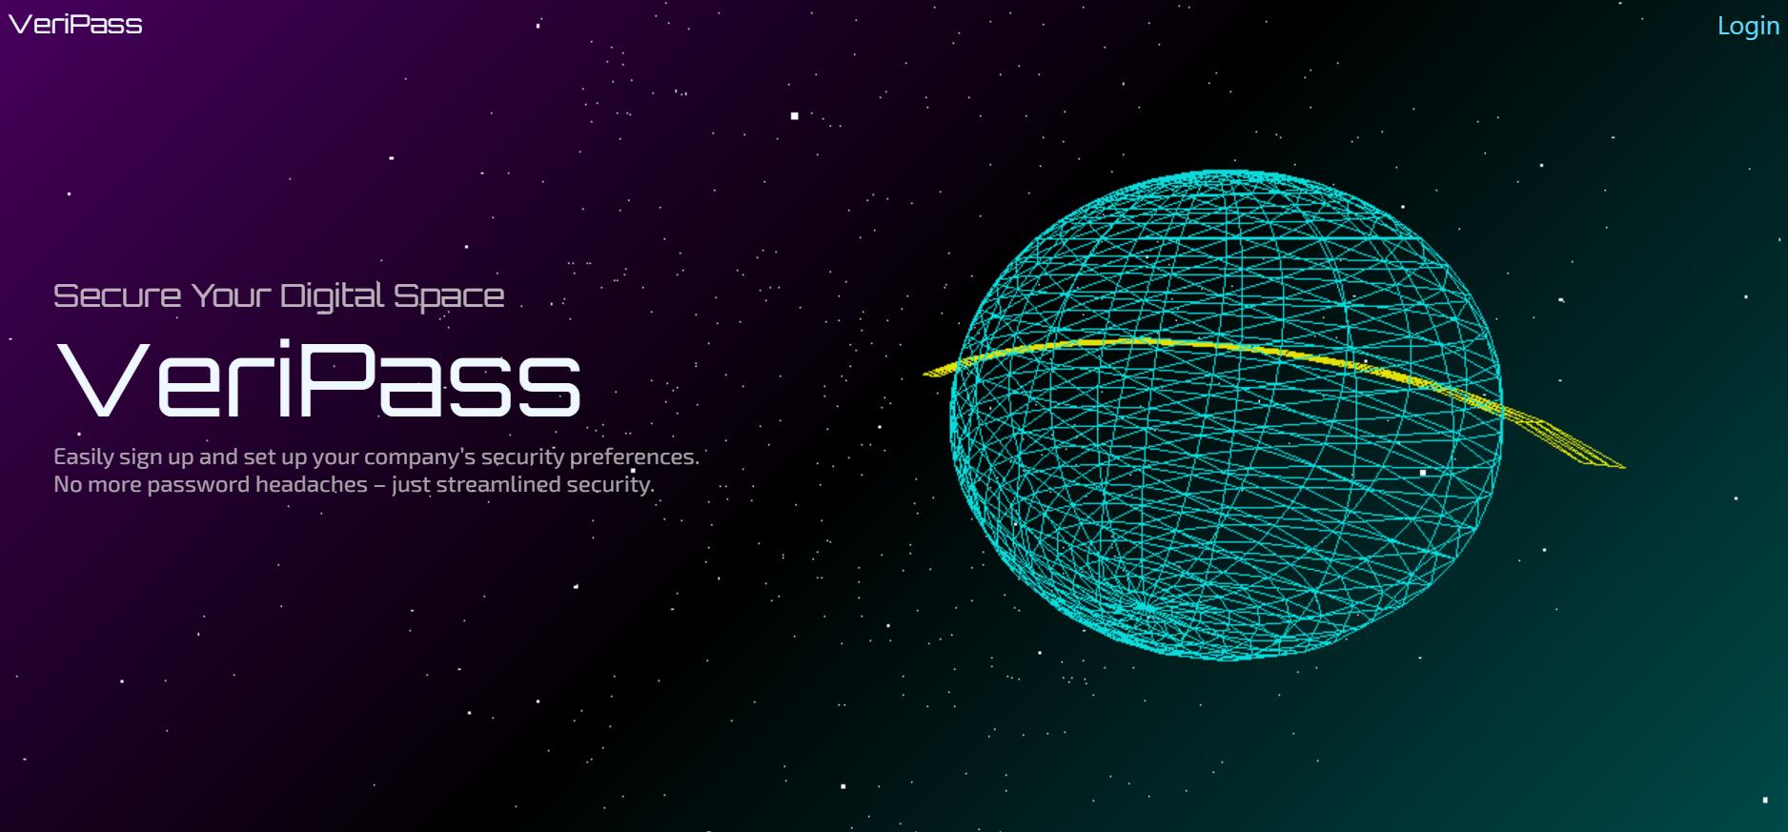
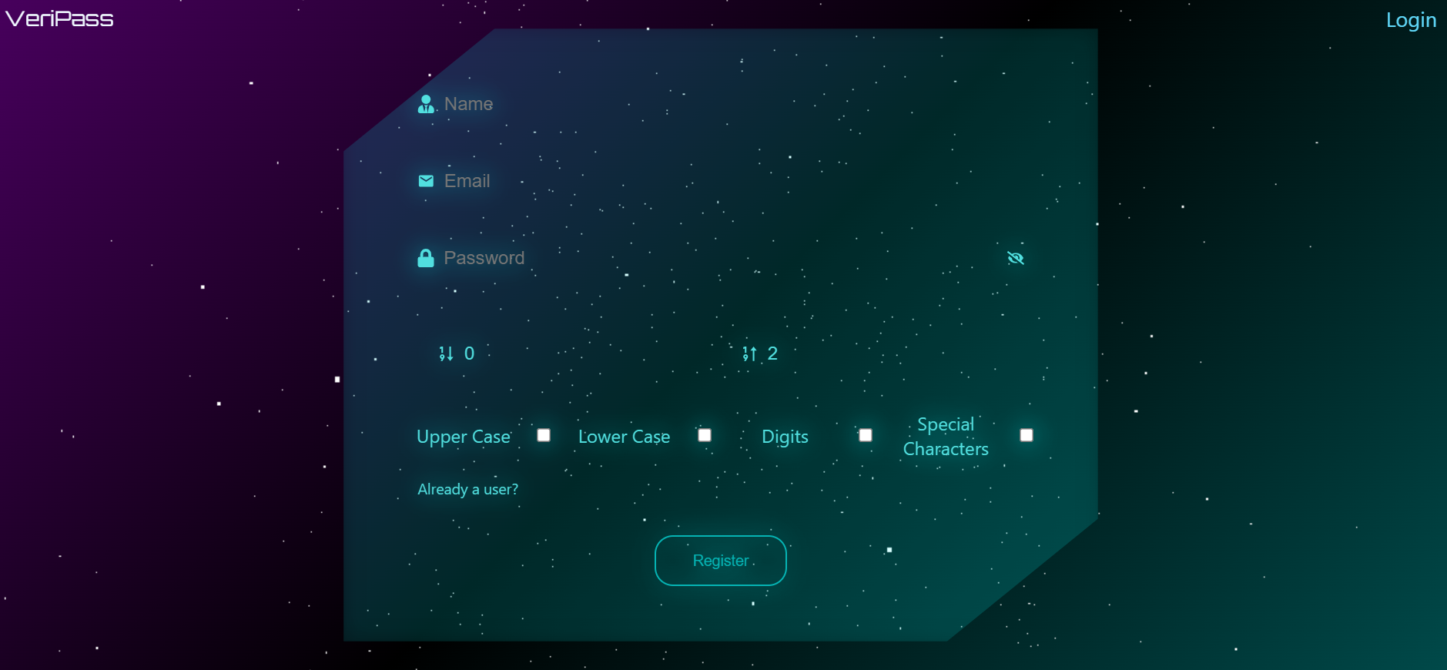
Demo

Slide 25
Future Scope
Advanced Password Policies
Implement complex rules and periodic changes.
Network Slicing
create isolated, secure segments of the network for different types of traffic.
User Behavior Analytics
Detect suspicious activities.
Third-Party Integration
Connect with external authentication services.
Mobile Application
Develop a mobile app for easy access.
Real-Time Security Alerts
Provide instant alerts for breaches.
AI Recommendations
Use AI for personalized security tips.

Slide 26
Thank You

